Slide 1
FOURda Code!

Slide 2





Rose Bianca Pano
Jogie Otic
Dante Baldonado
Feliza Dia

Slide 3
Athena Perb’s Catering Services:
A POS and Inventory
Software-based System

Slide 4
PROBLEM STATEMENT:
WHY BUILD THIS KIND OF SYSTEM?
To help Athena Pherb’s Catering Services to record their transactions since they are having a hard time computing their sales.
To speed up the transactions of the inventory and point of sale of Athena Pherb’s Catering Services and for it to not be time consuming since there are only a few employees in Athena Pherb’s Catering Services.
1

Slide 5
WHAT IS NEEDED IN THE SYSTEM TO SOLVE THE PROBLEM?
Since Athena Pherb’s Catering Services only has a record book, it would take a lot of time computing their sales so the solution is? A POS AND INVENTORY SOFTWARE-BASED SYSTEM
2

Slide 6
TARGET USERS: OWNER & EMPLOYEES OF ATHENA PHERB’S CATERING SERVICES

Slide 7
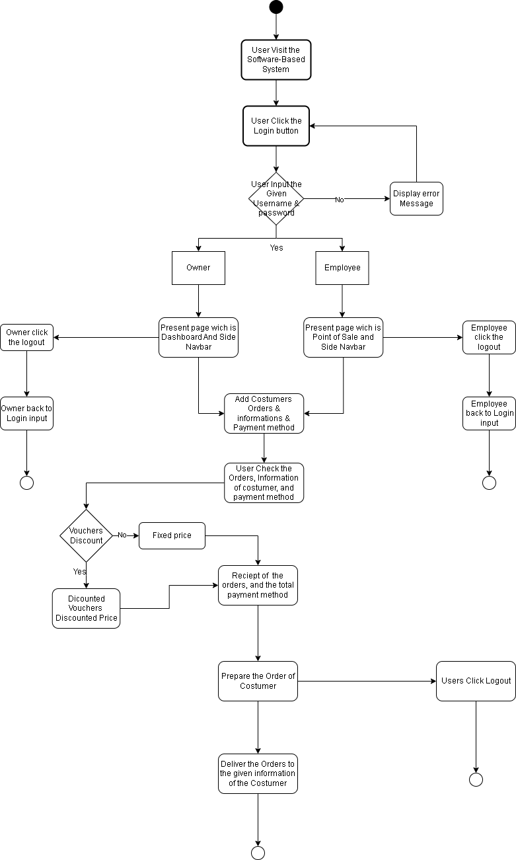
DIAGRAM/MODELS
FLOWCHART https://app.diagrams.net/#G16QeK9Y5YU185YvE9Mh4xOPBpnLPukKEr
3

Slide 8
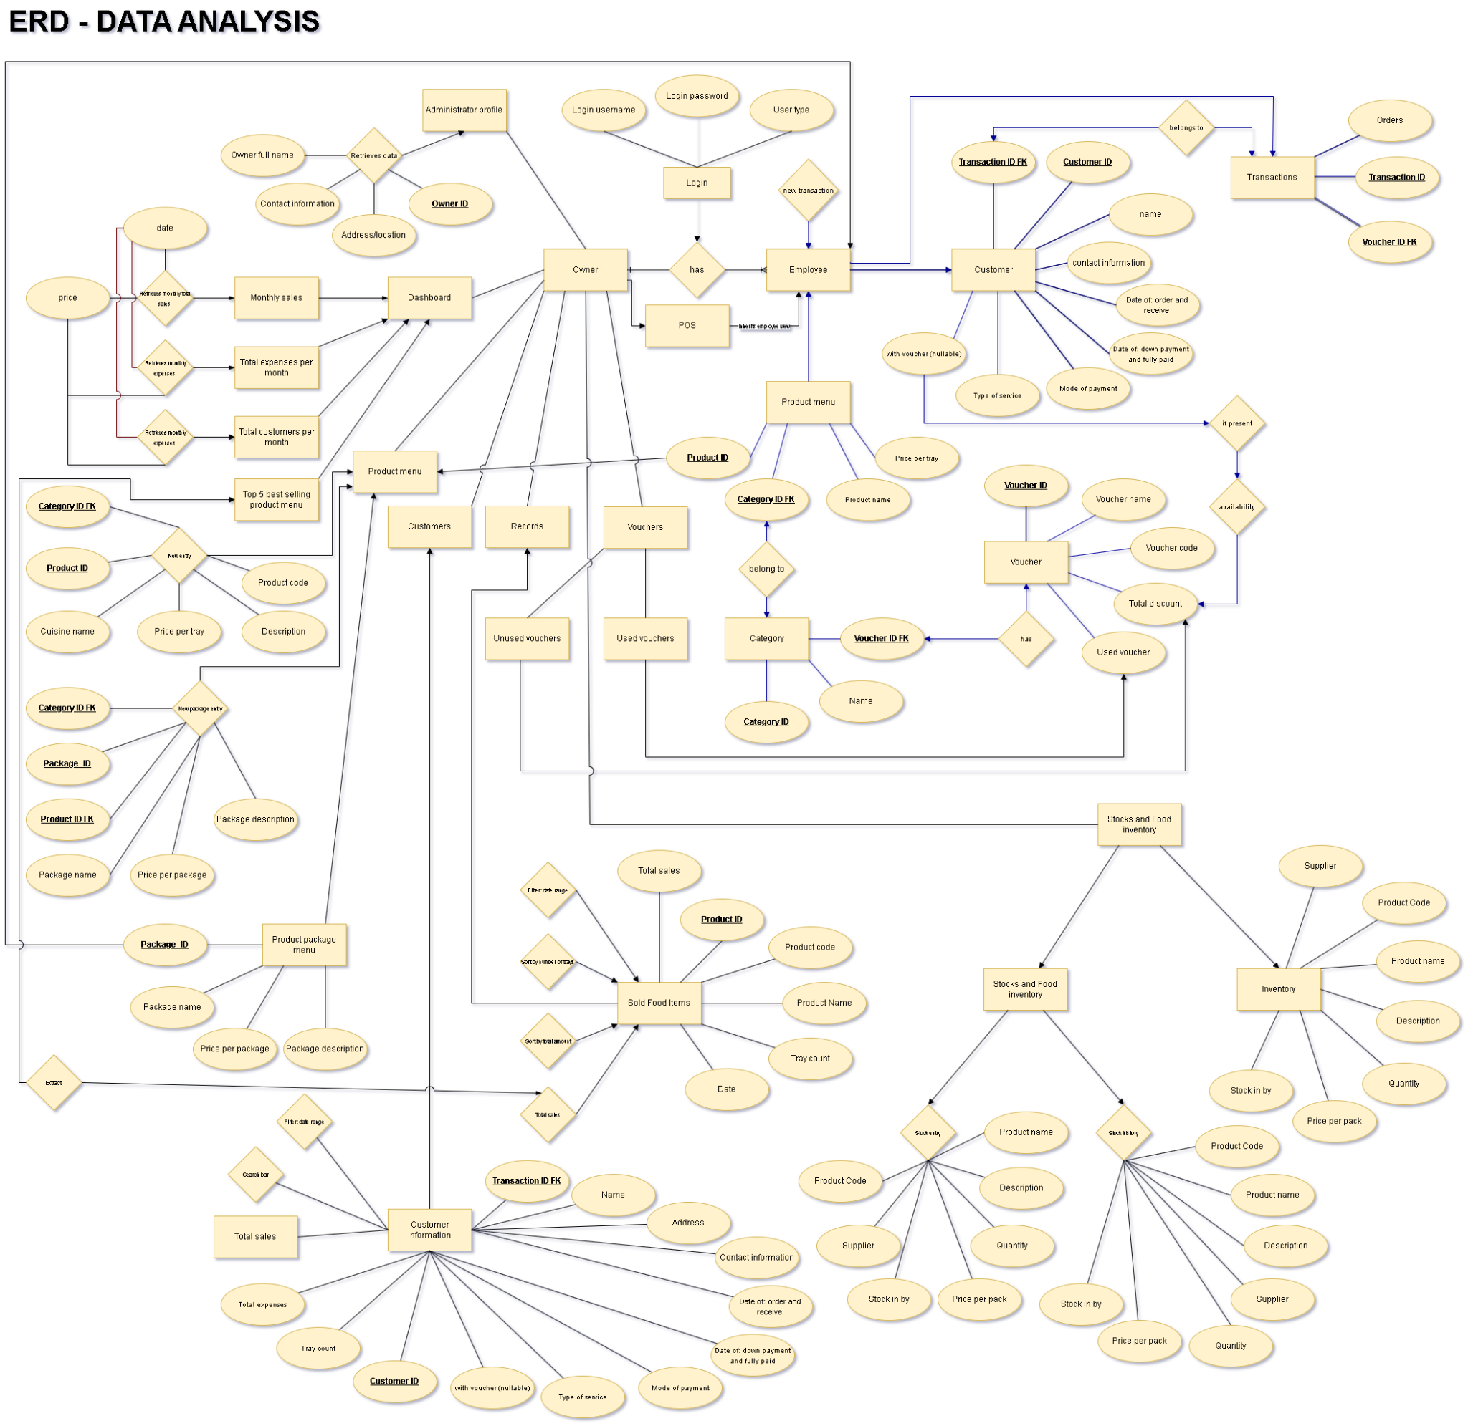
DIAGRAM/MODELS
ERD
https://app.diagrams.net/#G1K-jOdm03g36yn92jdnh_jIHoz-rWecyM
4

Slide 9
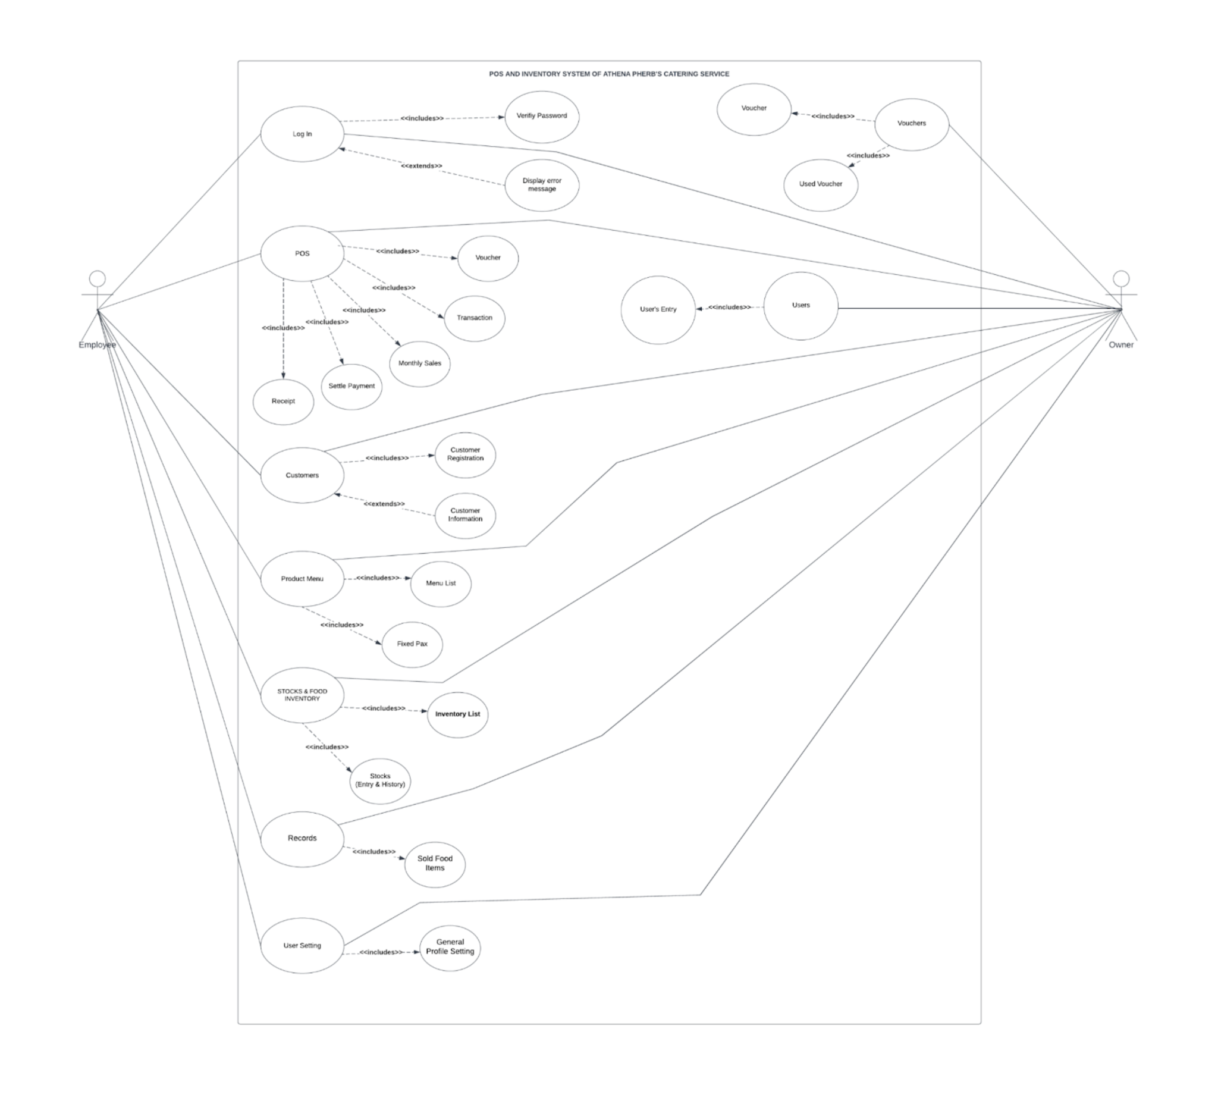
DIAGRAM/MODELS
USE CASE DIAGRAM https://app.diagrams.net/#G1K-jOdm03g36yn92jdnh_jIHoz-rWecyM
5

Slide 10
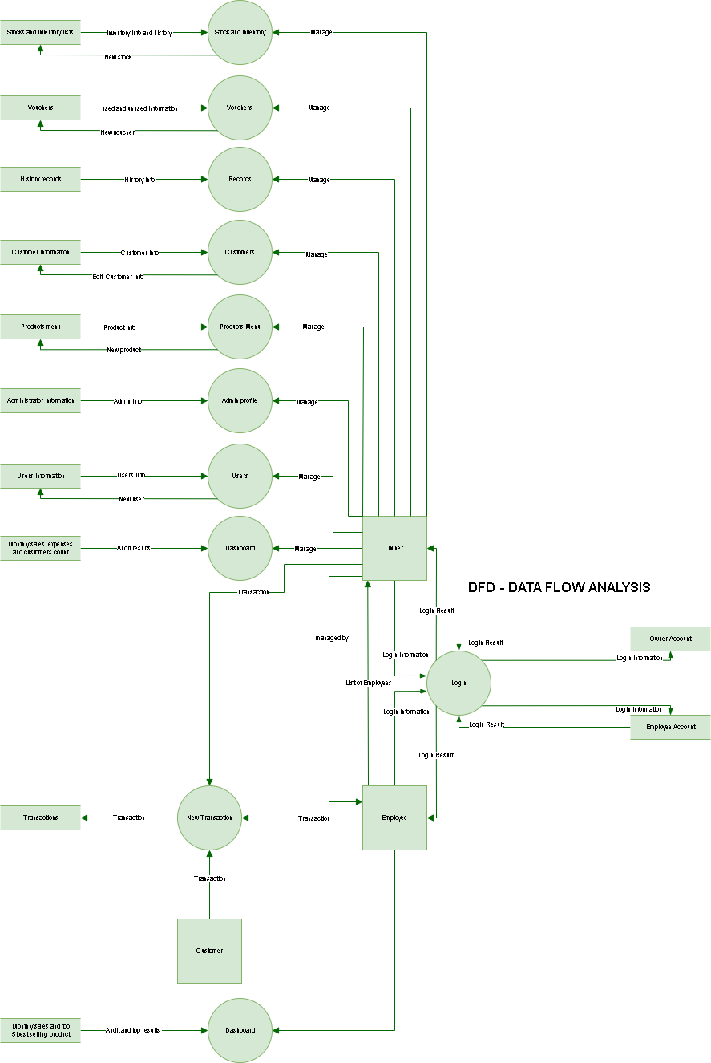
DIAGRAM/MODELS
DATA FLOW DIAGRAM (DFD)
https://app.diagrams.net/#G1K-jOdm03g36yn92jdnh_jIHoz-rWecyM
6

Slide 11
MOCK PROTOTYPE
6

Slide 12
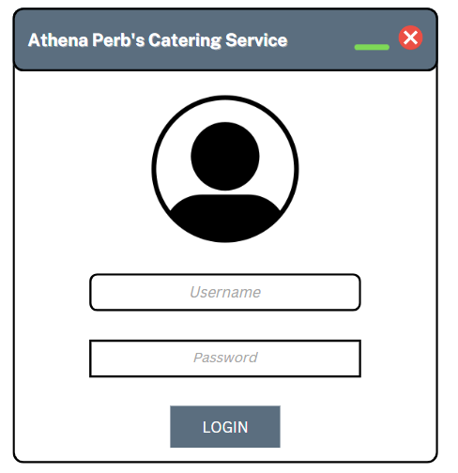
FEATURES OF THIS SYSTEM
USER LOGIN
7

Slide 13
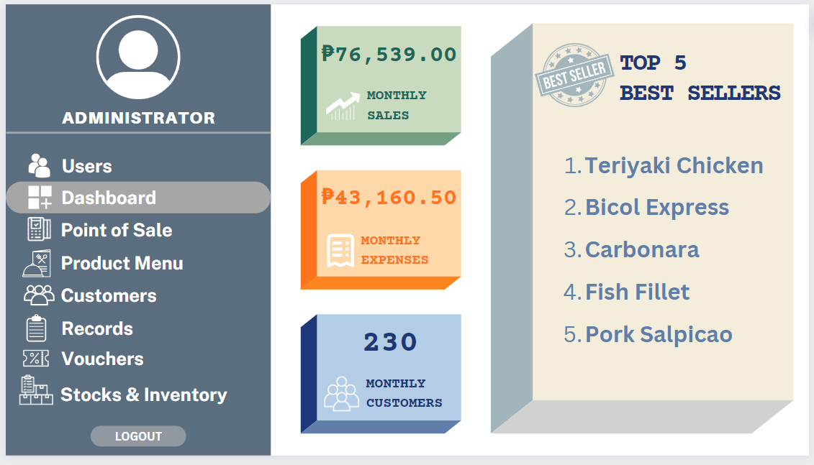
FEATURES OF THIS SYSTEM
DASHBOARD - OWNER
8

Slide 14
FEATURES OF THIS SYSTEM
DASHBOARD - EMPLOYEE
9

Slide 15
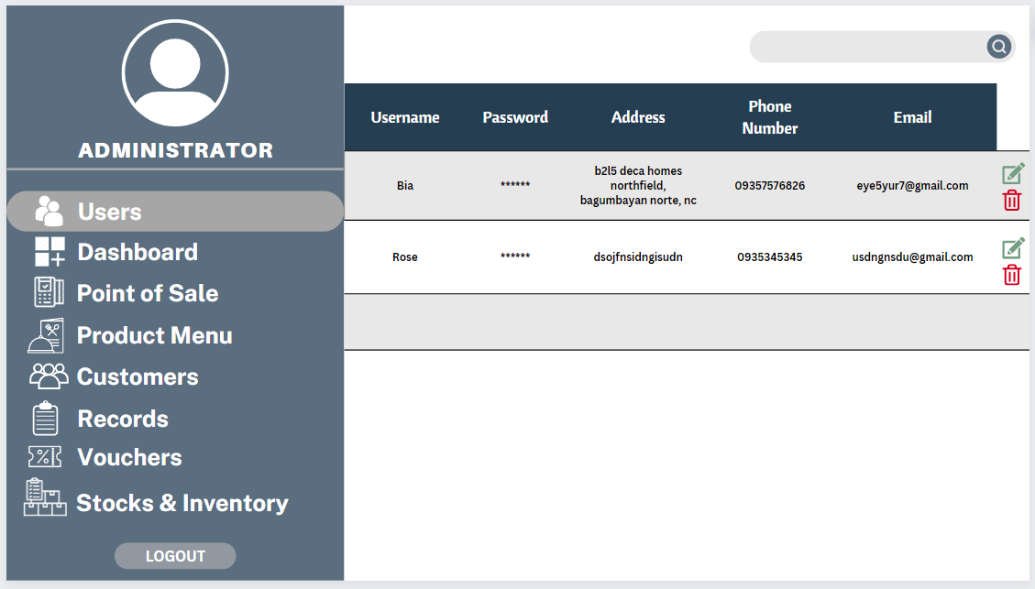
FEATURES OF THIS SYSTEM
USERS OWNER POV
10

Slide 16
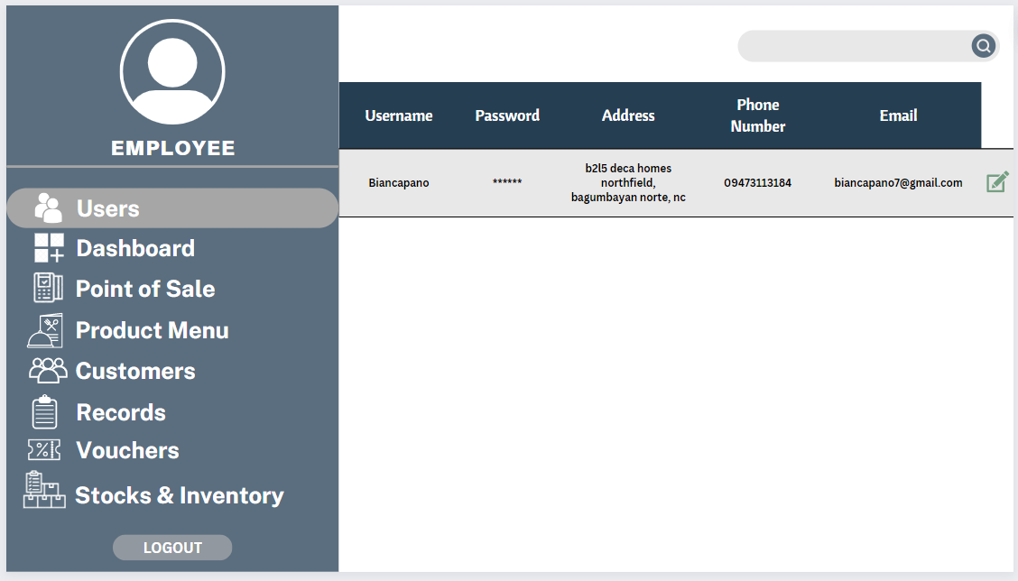
FEATURES OF THIS SYSTEM
USERS EMPLOYEE POV
11

Slide 17
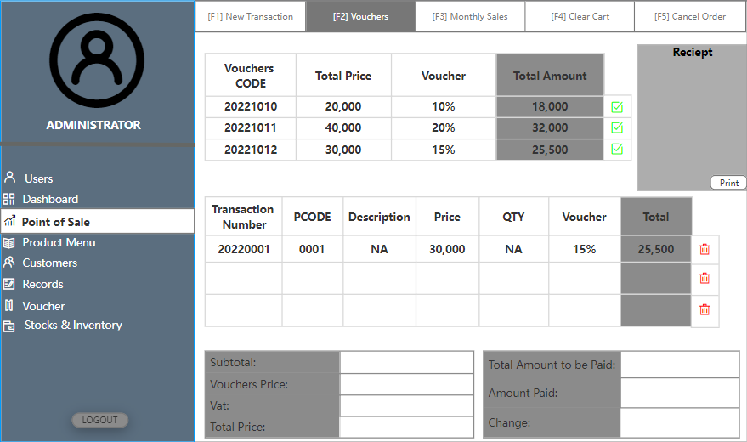
FEATURES OF THIS SYSTEM
POS OWNER POV
9

Slide 18
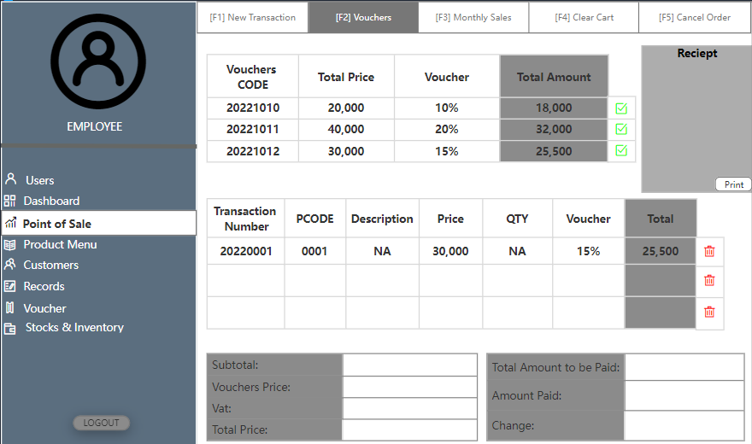
FEATURES OF THIS SYSTEM
POS EMPLOYEE POV
10

Slide 19
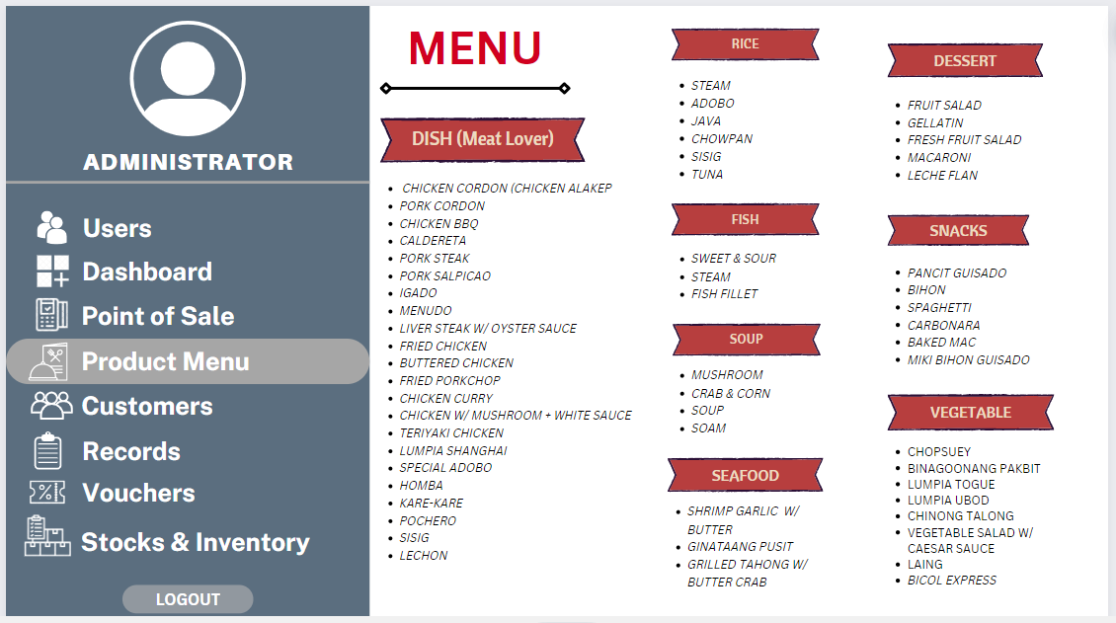
FEATURES OF THIS SYSTEM
PRODUCT MENU OWNERS POV
11

Slide 20
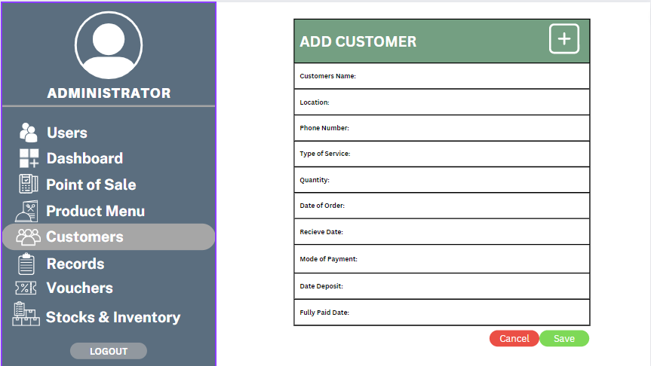
FEATURES OF THIS SYSTEM
CUSTOMERS OWNERS POV
12

Slide 21
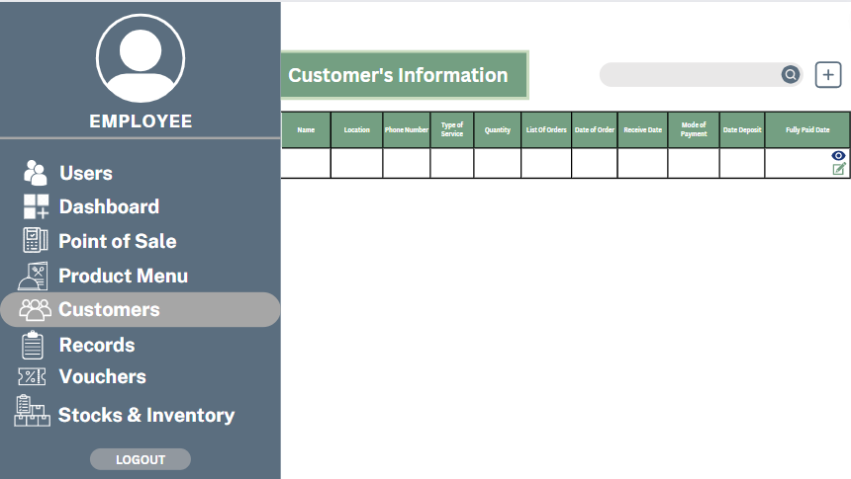
FEATURES OF THIS SYSTEM
CUSTOMERS EMPLOYEE POV
13

Slide 22
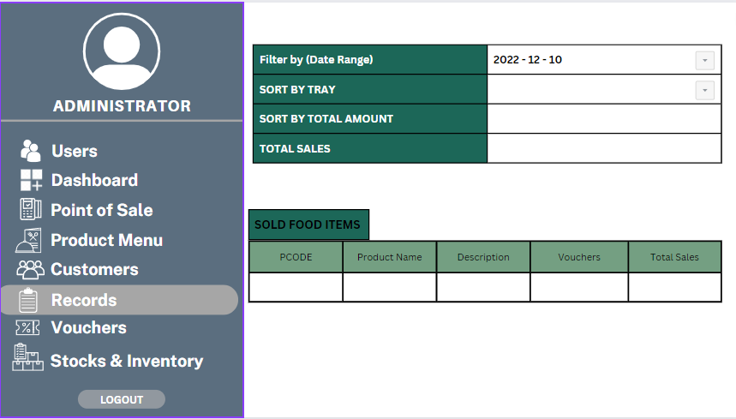
FEATURES OF THIS SYSTEM
RECORDS OWNER POV
14

Slide 23
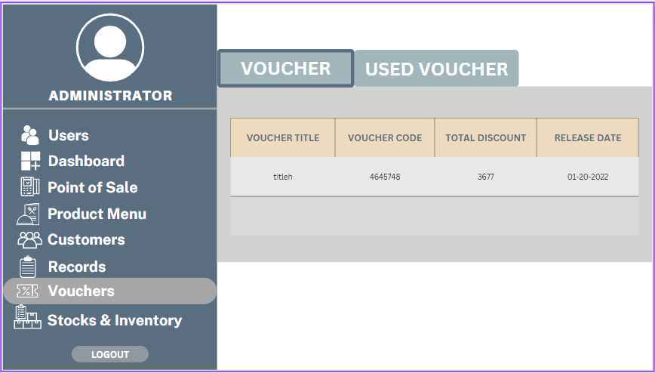
FEATURES OF THIS SYSTEM
VOUCHERS OWNER POV
15

Slide 24
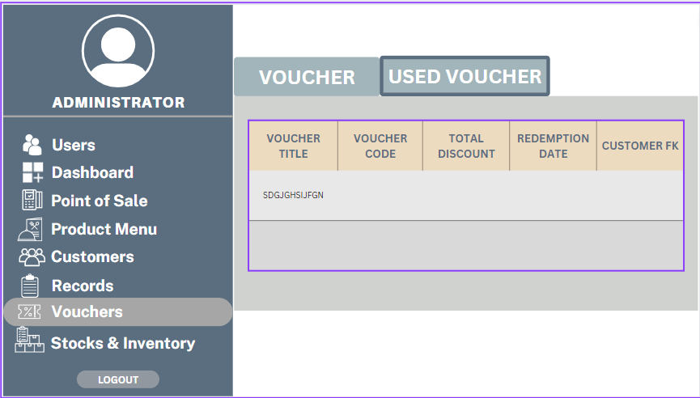
FEATURES OF THIS SYSTEM
VOUCHERS OWNER POV
16

Slide 25
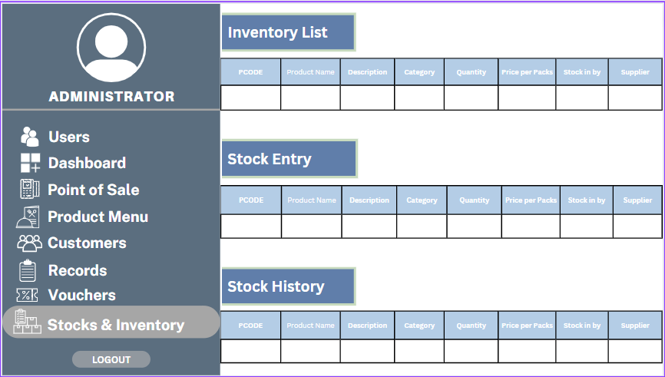
FEATURES OF THIS SYSTEM
STOCKS AND INVENTORY OWNER POV
17

Slide 26
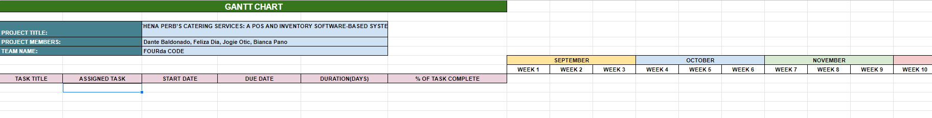
GANTT CHART
https://docs.google.com/spreadsheets/d/1X2O2oJykjImg7enwmCRABCdhJxgYtOM4p8OieaFvXBA/edit#gid=0
18

Slide 27
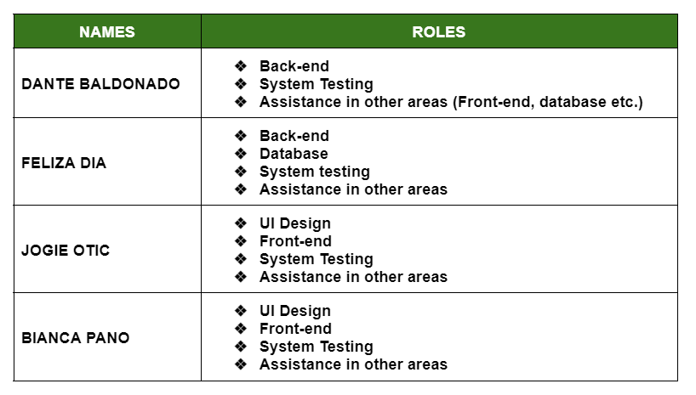
PHYSICAL ALLOCATION
19

Slide 28
THAT’S ALL THANK YOU!!!

